Slide 1
Category review: Chips
June 2020
Retail Analytics
Brand note: If client logo is not required, use alternate title page layout right click slide thumbnail > Layout > Title

Slide 2
Notes:
To view Privacy video explaining how important data privacy is to Quantium, please click here: https://www.youtube.com/watch?v=Zq1QDAkoRzU
or here Q:\Company Reference\Brand & Design\Brand videos\Q Privacy.mp4
At Quantium, we believe that data is the behavioural footprint of humanity and that it has to be treated with the utmost care and responsibility.
Histories, attitudes, indeed lives are stored within it in ways that aren’t always apparent – and that’s what makes its potential so powerful.
To work with it responsibly, sensitively, we set ourselves the highest data privacy protection and governance standards.
We have spent 17 years perfecting privacy-by-design and secure-by-design principles. Central to this is not holding any personally identifiable information about people –
we neither receive it, and put the necessary protections in place to be unable to decipher it.
Every aspect of handling data is safeguarded: from its de-identification, to its encryption – data security is paramount and of the highest grade.
We pride ourselves on gaining the trust of iconic organisations around the world through years of securely working with their data,
and in turn the trust that builds with their stakeholders.

Slide 3
Executive summary
01
Task 1
Here you will include your high-level findings and any key callouts for task 1
Older families in Budget, Young singles/couples, and retirees shoppers in Mainstream. This is because Young Singles/ Couples and retires are more of the customers than others.
02
Task 2
Here you will include your high-level findings and any key callouts for task 2
Trial stores 77 and 88 during the trial period show a significant difference in at least two of the three trial months but this is not the case for trial store 86.

Slide 4
01
Category
Mainstream
Young singles/couples and
Retirees

Slide 5
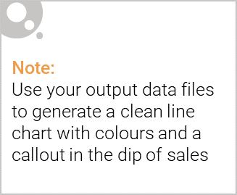
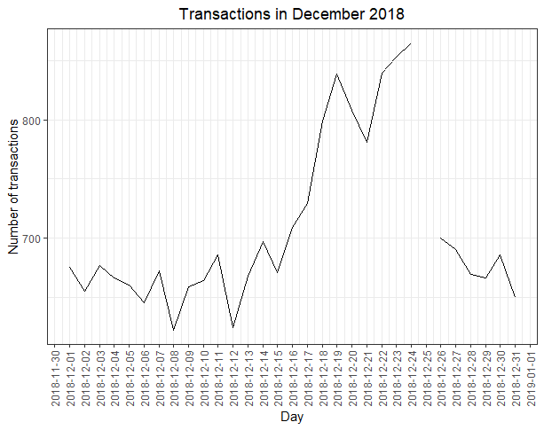
Overview: your key callout for the category should be included here
There was a dip in sales on December 25th, Because of the Christmas Holiday.

Slide 6
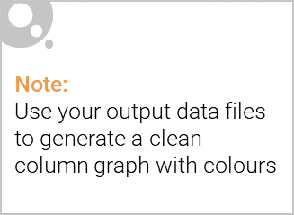
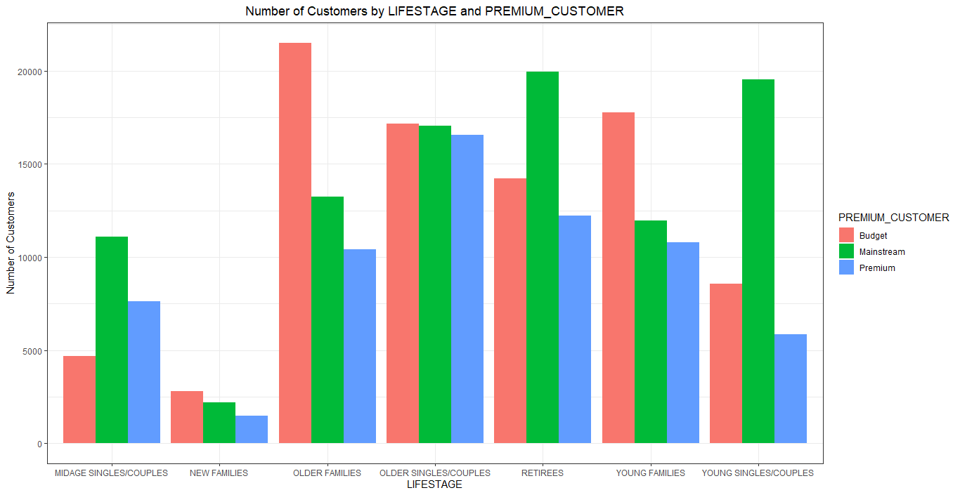
This slide will be commentary on affluence and its effect on consumer buying for the category of chips
Young Singles/Couples and retirees are more in terms of customers than other buyers. Mainstream, mid-age and young singles and couples are also more likely to pay more per packet of chips.

Slide 7
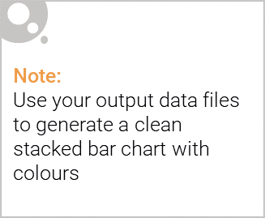
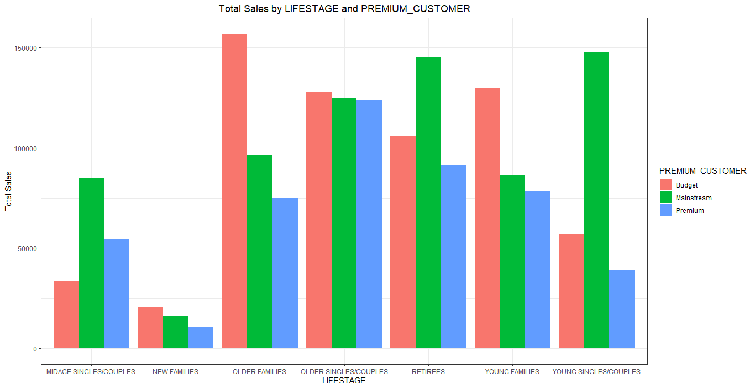
Editable (delete this)
Stretch: Try visualising the proportion of customers by affluence and life stage on this slide
Lifestage’s Purchases is an indication of impulse buying behaviour. Mainstream’s young singles and couples are 23% more likely to purchase Tyrrells chips compared to the rest of the population

Slide 8
02
Trial store performance
Trial stores
77
86 and
88

Slide 9
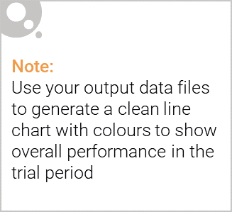
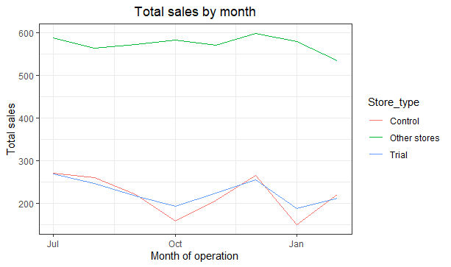
Explanation of the control store vs other stores
This shows the performance of Sales between Control, trial stores and other stores

Slide 10
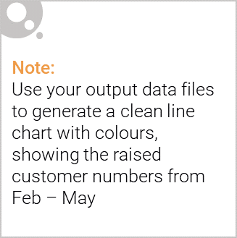
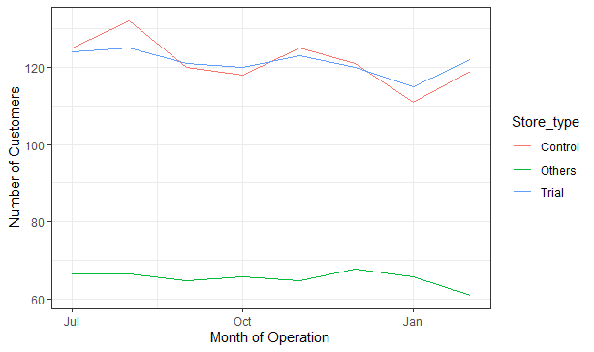
Call out of the performance in the trial store, determining if it was successful
This shows that the performance of the trial stores were successful as the number of customers increased when compared to Control Stores and Other Stores.

